Slide 1
Group 5 : Class on Creativity and Innovation NCAT 2012
@ IIT Delhi – DMS 2nd to 6th July 2012

Slide 2
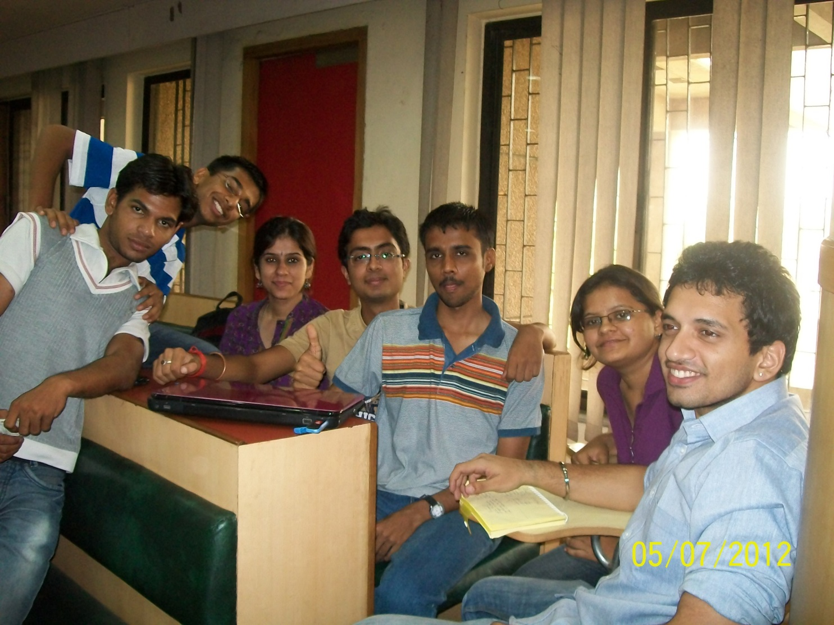
The Problem KEY-Lers
Siddhant Aggarwal
Rishabh Khare
Nidhi Zanwar
Ravindra
Kumar
Vinayak Raja
Garima Capoor
RK Sanjeev Kumar

Slide 3
Executive Summary
The Assignment: To identify a pain area for the common people, such that innovating a product/service for the same will result in some satisfaction and delight.
The Pain Area Targeted: Keeping track of lost keys/ small “losable” objects. (7,505 sets of keys were found by the London Transport in 2011- www.micro-trax.com/statistics)
The Product: A wrist watch with inbuilt/onboard sensors and some portable accompaniments that can be looped onto or stuck to keys etc. and connected via Bluetooth or wave frequencies. If the distance between the watch and the external sensor goes beyond 30 feet(approx.) they will start buzzing (vibration and flashing).
The Price: (Needs to be worked on) But the ranges can be for Top-end and Mid-Range Watches (Technology will be based on the target audience i.e. will be flexible)
Decision making tools used: Fish Bone (Cause-Effect), 6 Thinking Hats ( Varied Perspectives)
Competition in the Market: Sony Smart Watch, Kinsight - relies on several of Microsoft's Kinect sensors attached to a computer, Cobra Tag (Bluetooth), Lady’s Handbag (most reliable !!)

Slide 4
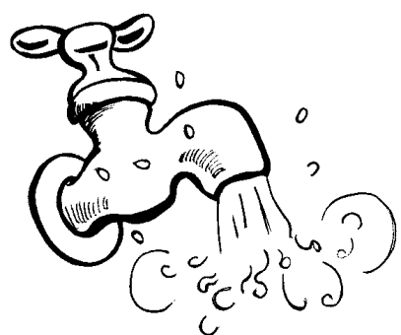
Top 3 Ideas
National Tourist
Help Centre
^{©Smartjeev}
Cooling the Hot tap
water in Summers
This is it..!! :-)
*Finding Lost Keys*

Slide 5
The Pain Area
“Memory Is an UNRELIABLE tool.”
- Prof. Raj Singh [ DMS: IIT-D]
How often do you ask, “Mom, where’s my key?”
The answer would be – “Really often.”
Losing keys is a very common habit shared by the people of all age’s. Be it a 12,24 or 55 yr old person, keys are something that are lost almost every single day.
7,505 sets of keys were found by the London Transport in 2011.
Insurance companies respond to over 500 lost key calls per day.

Slide 6
The Need of a Key Finder
A) Impact :
Large Target Audience
The problem caters on a daily basis.
The need to use this, never fades out.
B) Market :
The idea can be sold to any/many watch companies.
An entire new company can be set up on this idea.
C) Competition :
Key Ringer is a competitive product but is less popular and non-economical for the Indian population.
Cobra Tag, a mobile application is another competition but due to its being limited to the android OS and constant Bluetooth connection requirement, it also possesses a less competitive market.

Slide 7
Fish Bone
Personal
Misplace
Passing it on to someone else without remembering
locking it within an automatic door
leaving it behind subconsciously
someone else moved the key
not kept at the right place
Fell out of the pocket while travelling, playing, etc.
Hole in the pocket.
Pocket- small and loose.
Robbing of the key.
Losing A Key
small size
light weight
Camouflaged colors
Accidental
Structure

Slide 8
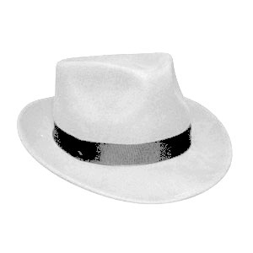
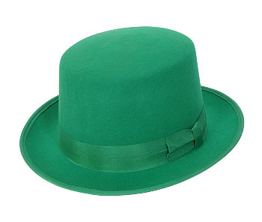
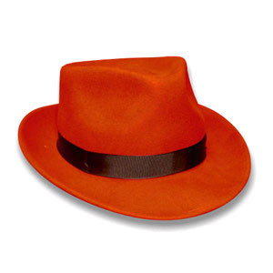
The 6 Thinking Hats
keys are small objects easy to loose
its a pain everyone faces
accidental lapses in memory have become common in the fast paced world
Retractable keychain that recoils the key back to its place
A mobile app. With GPS sensors/ Bluetooth to detect lost keys
A Watch with a sensor, which buzzes every time the key is out of range.
There will be a lapse in responsibility if a feasible solution to this problem is provided.
why get a new watch if you can buy a new key at a lesser
cost ?

Slide 9
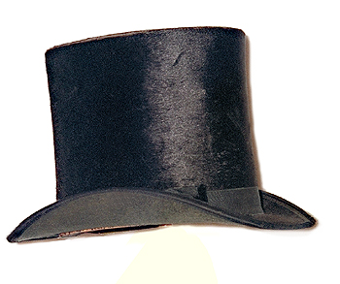
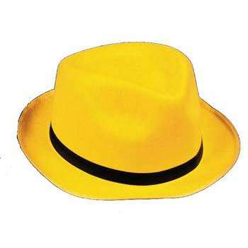
Retractable key-chains do not help in finding a lost key. It can get lost with the entire bunch of keys.
GPS Sensors for the watch will make it uneconomical.
Useless in Crowded place.
It will be a source of comfort with a poor memory.
Watch companies will be attracted by this venture.
Monopoly of a company, having such a multi-purpose watch can be easily established across the market in this competitive era.
Wrist watches with integrated circuits and external stick-on portable sensors is an economical, viable and durable solution.
The sensors would produce flashing light and buzz when out of range of the watch’s coverage area(say 30 ft.)
Portable stick-on sensors help expand the idea and not limit it to keys.

Slide 10
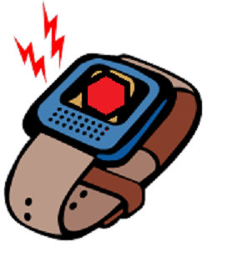
The Idea: A tool ( a wrist watch ) for helping people recover/ retrace and keep a track of important objects that can be easily misplaced.
The market: Homo sapiens with a regular memory lapse.
SWOT Analysis: Explained by the 6 thinking hats.
Marketing Mechanisms: The 4 P’s-
Product : A Key Locating Device.
Place : The INDIAN market.
Promotion : Campaigns/Competitions/Memory Games/Advertisements.
Price : Sector Specific (High and Middle income groups)

Slide 11
The jobsian Learnings

Slide 12
“ Simplicity is the ULTIMATE sophistication”
“If we don’ cannibalize ourselves, someone else will”
“ Intuition is a very powerful thing, more powerful than intellect”
“You did the impossible because you didn’t realize that it was impossible”
“ The people who are crazy enough to think they can change the world, are the ones who do”

Slide 13
DO STEVE JOBS
S
Simplify
T
Take Complete Responsibility
E
Empathize with focus groups
V
Vouch for perfection
E
Embrace Products against profits
J
Jut Beyond Reality
O
Omit Less important data
B
Bewitch the customer
S
“Stay Hungry, Stay Foolish”

Slide 14
TEAM
Garima Capoor | FACULTY OF ENGINEERING, DAYALBGH EDUCTIONAL INSTITUTE, AGRA
Siddhant Aggarwal | PANDIT DEENDAYAL PETROLEUM UNIVERSITY, GANDHINAGAR
Rishabh Khare | INDIAN INSTITUTE OF SCIENCE EDUCATION & RESEARCH, NADIA
Nidhi Zanwar | COLLEGE OF ENGINEERING PUNE, PUNE
Ravindra Kumar
RK Sanjeev Kumar | SACS M.A.V.M.M. EGINEERING COLLEGE, MADURAI
Vinayak Raja | ANSAL INSTITUTE OF TECHNOLOGY, GURGAON

